Slide 1
Chapter 3
Structure of a C Program
Objectives
❏ To be able to list and describe the six expression categories
❏ To understand the rules of precedence and associativity in
evaluating expressions
❏ To understand the result of side effects in expression evaluation
❏ To be able to predict the results when an expression is evaluated
❏ To understand implicit and explicit type conversion
❏ To understand and use the first four statement types: null, expression, return, and compound

Slide 2
3-1 Expressions
An expression is a sequence of operands and operators that reduces to a single value. Expressions can be simple or complex. An operator is a syntactical token that requires an action be taken. An operand is an object on which an operation is performed; it receives an operator’s action.
Topics discussed in this section:
Primary Expressions
Postfix Expressions
Prefix Expressions
Unary Expressions
Binary Expressions

Slide 3
Note
An expression always reduces to a single value.

Slide 4
FIGURE 3-1 Expression Categories

Slide 5
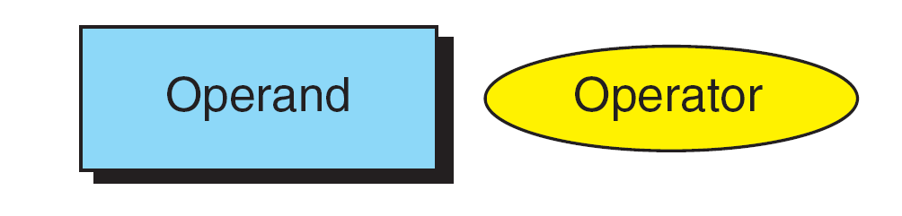
FIGURE 3-2 Postfix Expressions

Slide 6
Note
(a++) has the same effect as (a = a + 1)

Slide 7
FIGURE 3-3 Result of Postfix a++

Slide 8
Note
The operand in a postfix expression must be a variable.

Slide 9
PROGRAM 3-1
Demonstrate Postfix Increment

Slide 10
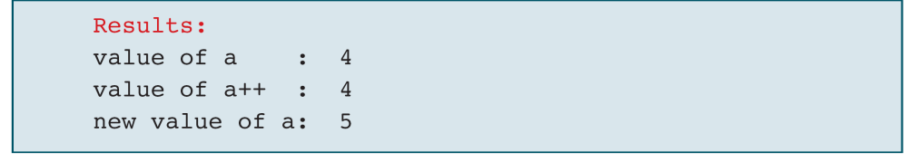
PROGRAM 3-1
Demonstrate Postfix Increment (continued)

Slide 11
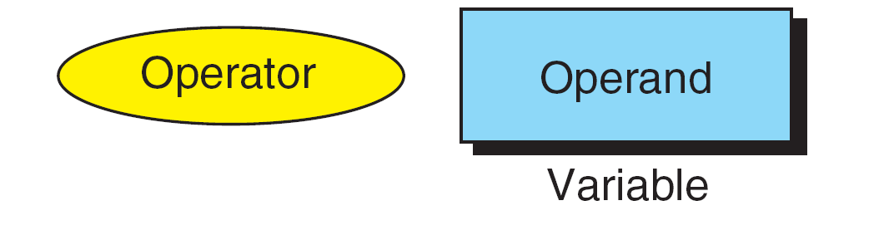
FIGURE 3-4 Prefix Expression

Slide 12
Note
The operand of a prefix expression must be a variable.

Slide 13
FIGURE 3-5 Result of Prefix ++a

Slide 14
Note
(++a) has the same effect as (a = a + 1)

Slide 15
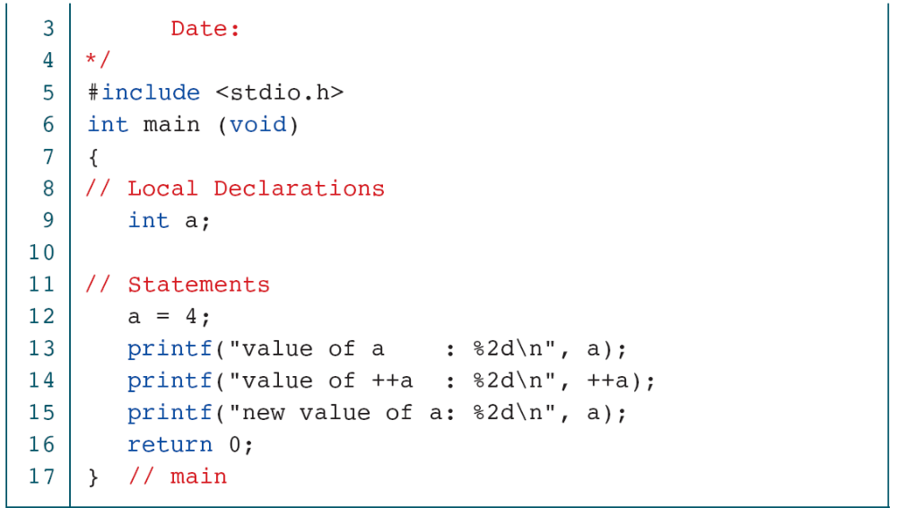
PROGRAM 3-2
Demonstrate Prefix Increment

Slide 16
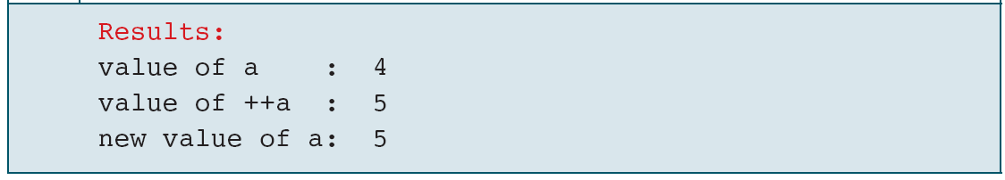
PROGRAM 3-2
Demonstrate Prefix Increment (continued)

Slide 17
Note
If ++ is after the operand, as in a++, the increment takes place after the expression is evaluated.
If ++ is before the operand, as in ++a, the increment
takes place before the expression is evaluated.

Slide 18
FIGURE 3-6 Unary Expressions

Slide 19
Table 3-1
Examples of Unary Plus And Minus Expressions

Slide 20
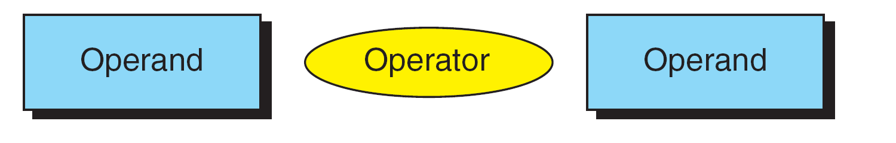
FIGURE 3-7 Binary Expressions

Slide 21
Note
Both operands of the modulo operator (%) must
be integral types.

Slide 22
PROGRAM 3-3
Binary Expressions

Slide 23
PROGRAM 3-3
Binary Expressions (continued)

Slide 24
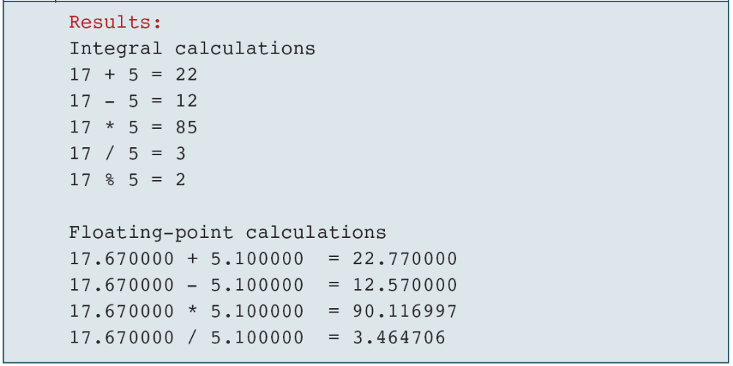
PROGRAM 3-3
Binary Expressions (continued)

Slide 25
Note
The left operand in an assignment expression must be a single variable.

Slide 26
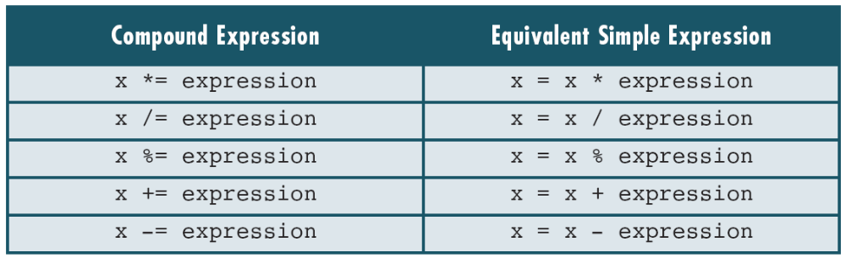
Table 3-2
Expansion of Compound Expressions

Slide 27
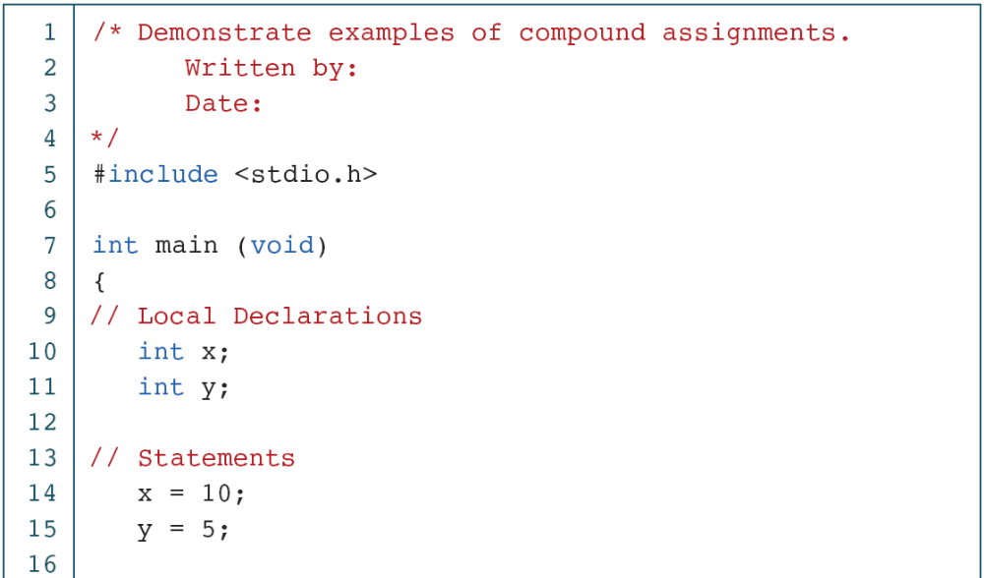
PROGRAM 3-4
Demonstration of Compound Assignments

Slide 28
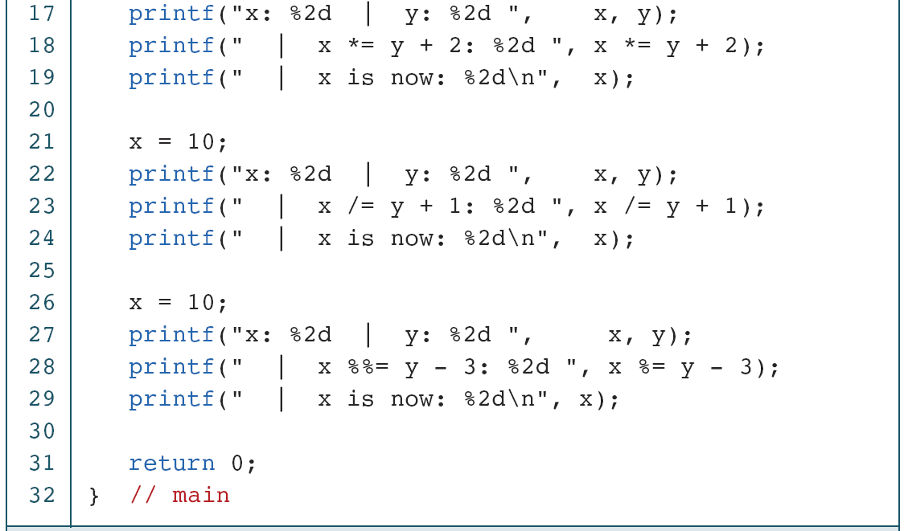
PROGRAM 3-4
Demonstration of Compound Assignments

Slide 29
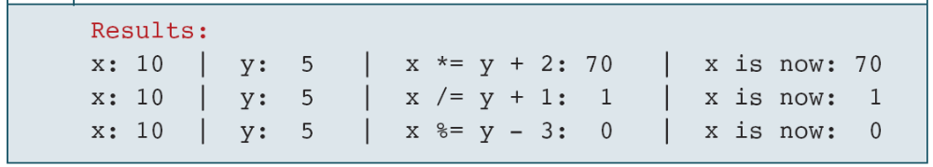
PROGRAM 3-4
Demonstration of Compound Assignments

Slide 30
3-2 Precedence and Associativity
Precedence is used to determine the order in which different operators in a complex expression are evaluated. Associativity is used to determine the order in which operators with the same precedence are evaluated in a complex expression.
Topics discussed in this section:
Precedence
Associativity

Slide 31
PROGRAM 3-5
Precedence

Slide 32
PROGRAM 3-5
Precedence

Slide 33
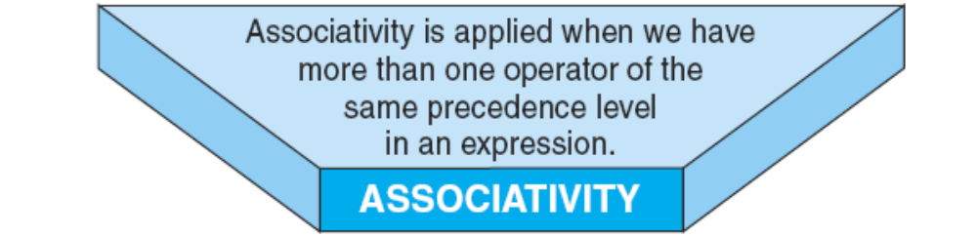

Slide 34
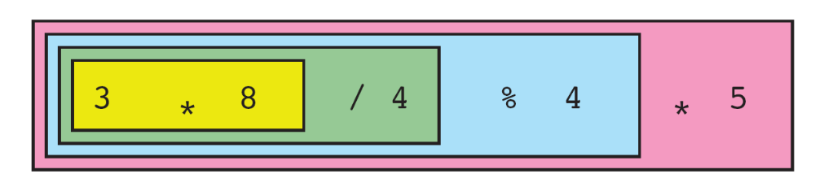
FIGURE 3-8 Left-to-Right Associativity

Slide 35
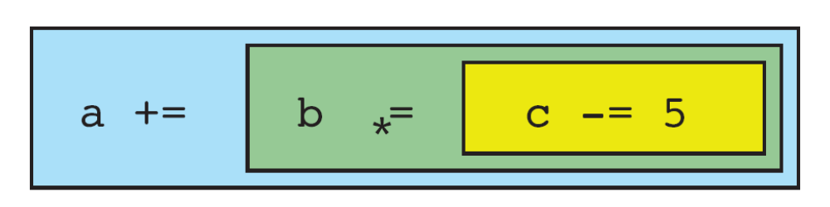
FIGURE 3-9 Right-to-Left Associativity

Slide 36
3-3 Side Effects
A side effect is an action that results from the evaluation of an expression. For example, in an assignment, C first evaluates the expression on the right of the assignment operator and then places the value in the left variable. Changing the value of the left variable is a side effect.

Slide 37
3-4 Evaluating Expressions
Now that we have introduced the concepts of precedence, associativity, and side effects, let’s work through some examples.
Topics discussed in this section:
Expressions without Side Effects
Expressions with Side Effects

Slide 38
PROGRAM 3-6
Evaluating Expressions

Slide 39
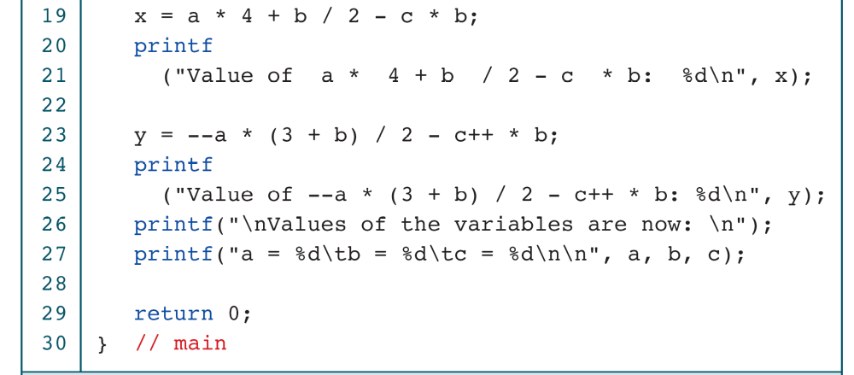
PROGRAM 3-6
Evaluating Expressions

Slide 40
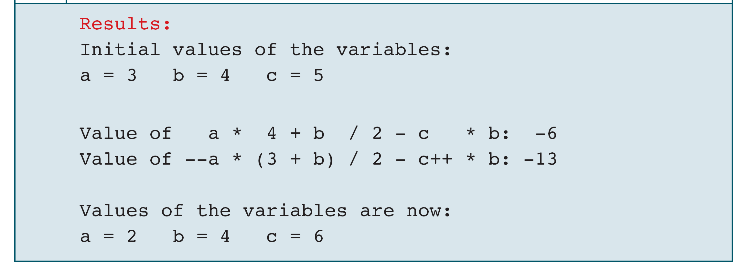
PROGRAM 3-6
Evaluating Expressions

Slide 41
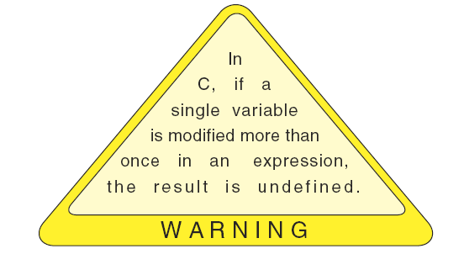
Warning

Slide 42
3-5 Type Conversion
Up to this point, we have assumed that all of our expressions involved data of the same type. But, what happens when we write an expression that involves two different data types, such as multiplying an integer and a floating-point number? To perform these evaluations, one of the types must be converted.
Topics discussed in this section:
Implicit Type Conversion
Explicit Type Conversion (Cast)

Slide 43
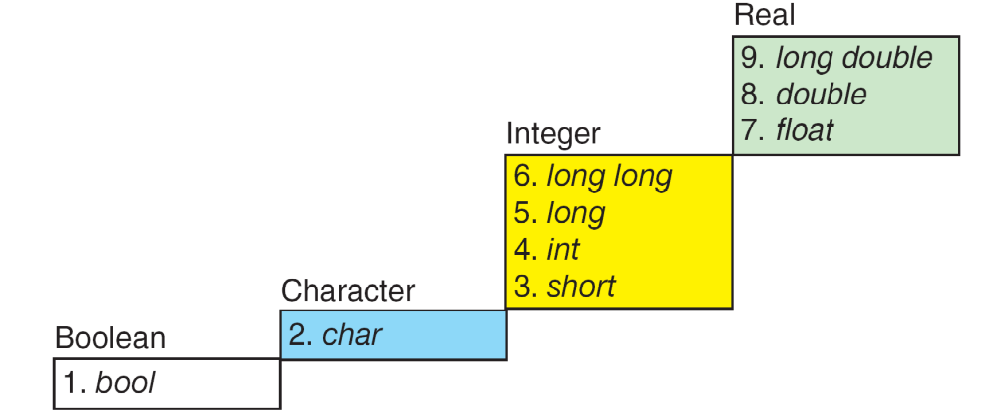
FIGURE 3-10 Conversion Rank

Slide 44
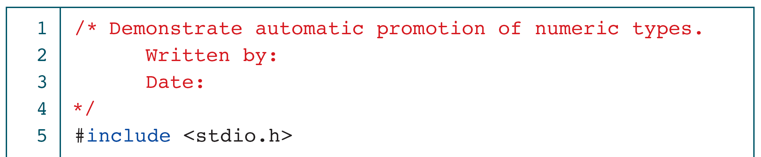
PROGRAM 3-7
Implicit Type Conversion

Slide 45
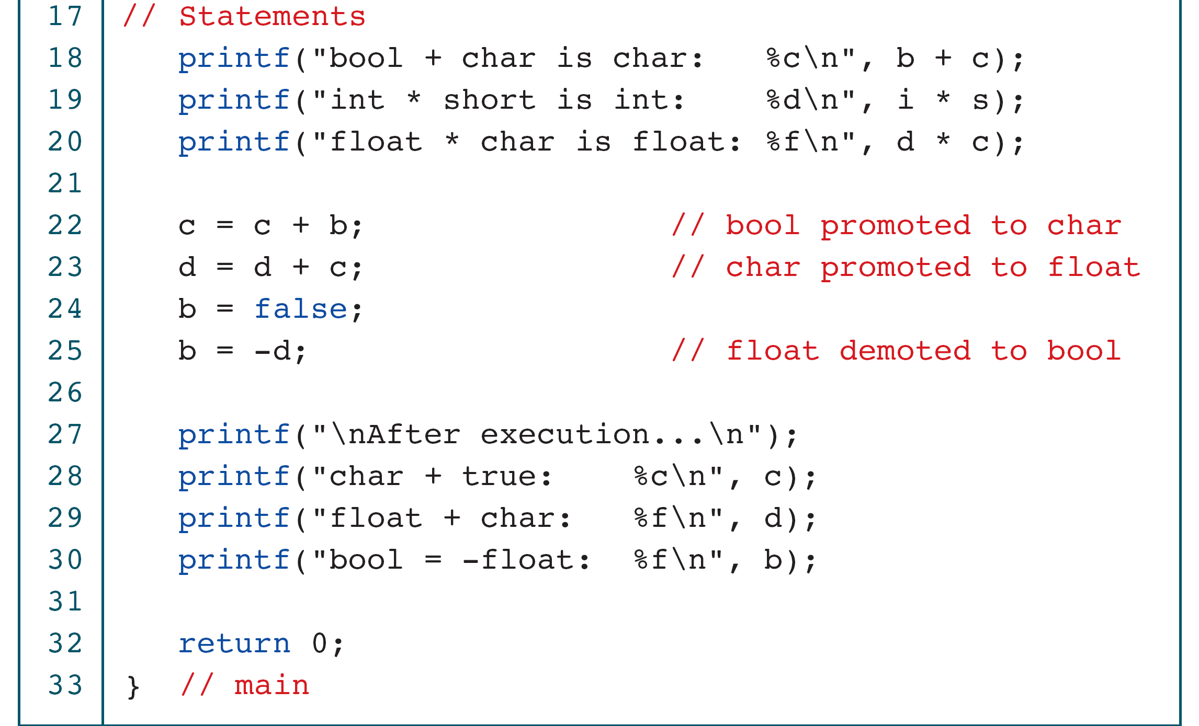
PROGRAM 3-7
Implicit Type Conversion

Slide 46
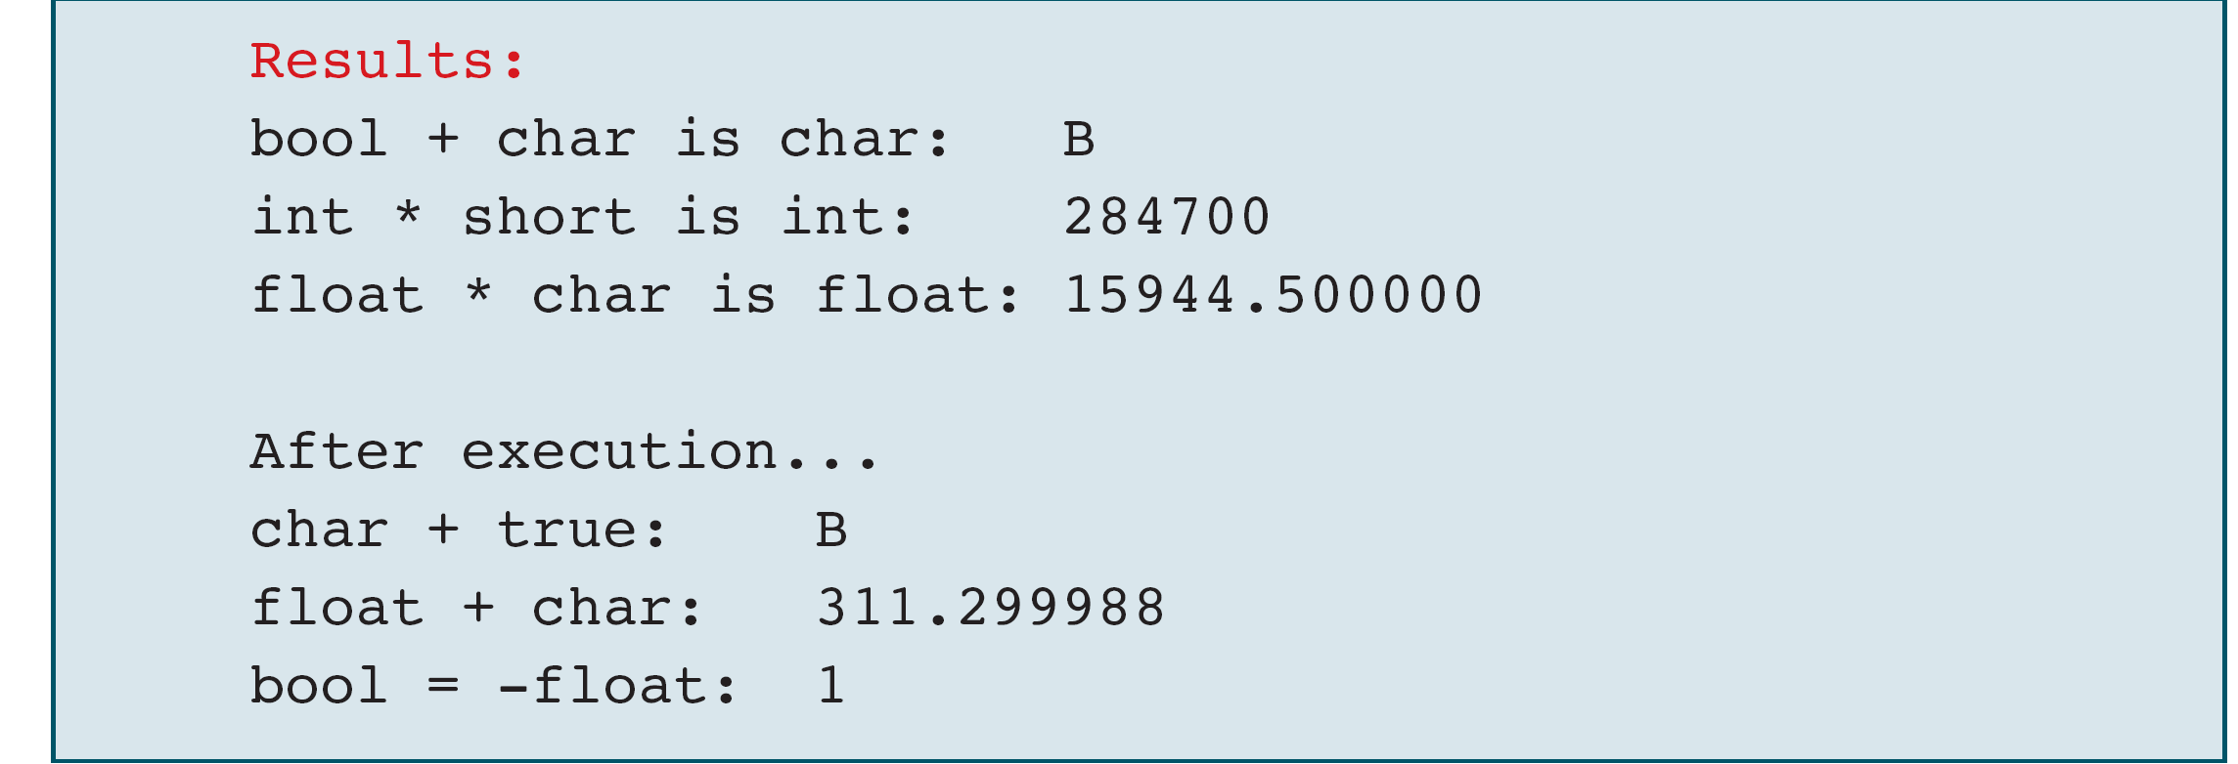
PROGRAM 3-7
Implicit Type Conversion

Slide 47
PROGRAM 3-8
Explicit Casts

Slide 48
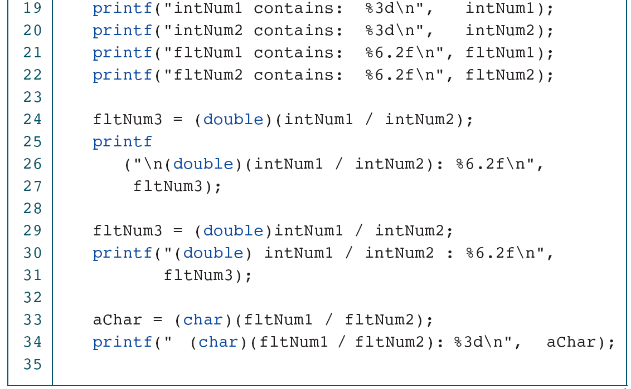
PROGRAM 3-8
Explicit Casts

Slide 49
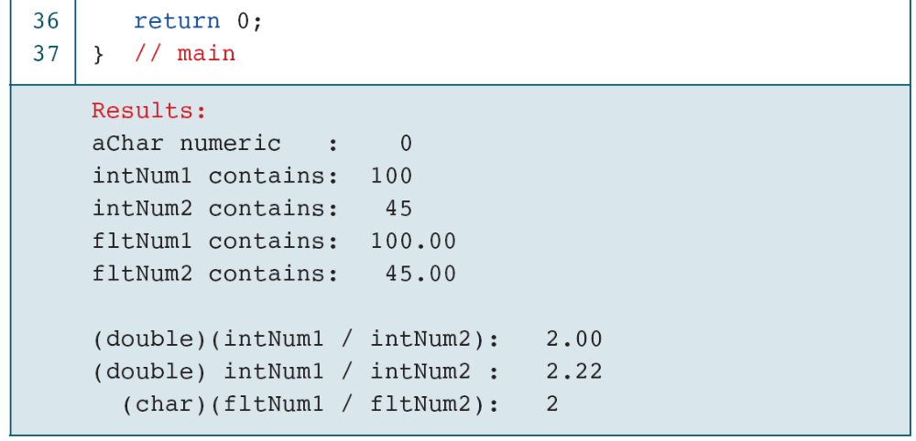
PROGRAM 3-8
Explicit Casts

Slide 50
3-6 Statements
A statement causes an action to be performed by the program. It translates directly into one or more executable computer instructions.
You may have noticed that we have used a semicolon at the end of the statements in our programs. Most statements need a semicolon at the end; some do not.
Topics discussed in this section:
Statement Type
The Role of the Semicolon
Statements and Defined Constants

Slide 51
FIGURE 3-11 Types of Statements

Slide 52
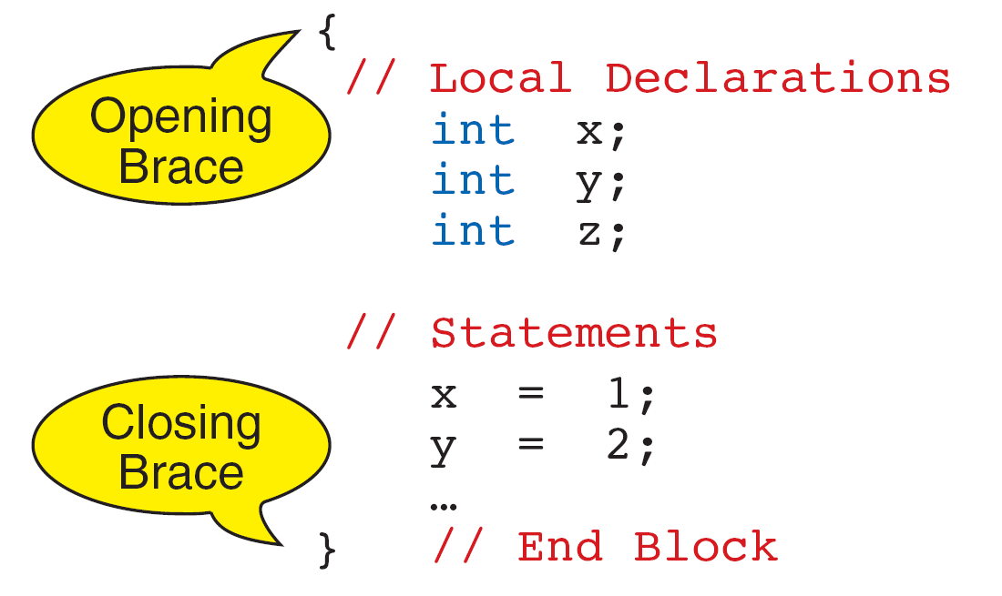
FIGURE 3-12 Compound Statement

Slide 53
Note
The compound statement does not need a semicolon.

Slide 54
3-7 Sample Programs
This section contains several programs that you should study for programming technique and style.

Slide 55
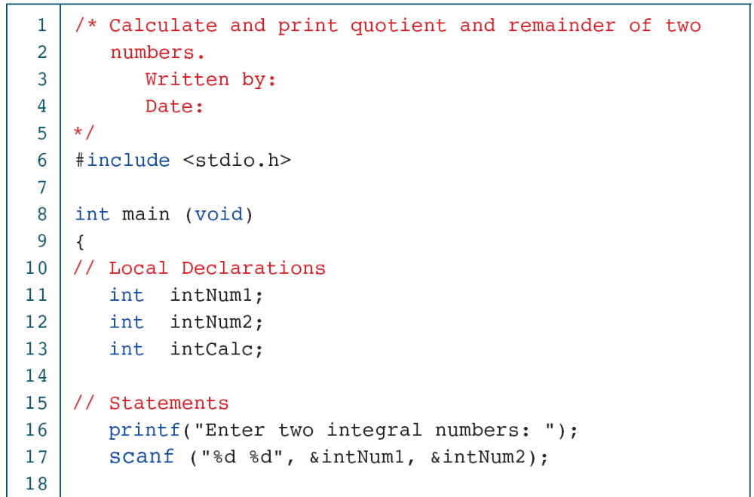
PROGRAM 3-9
Calculate Quotient and Remainder

Slide 56
PROGRAM 3-9
Calculate Quotient and Remainder

Slide 57
PROGRAM 3-10
Print Right Digit of Integer

Slide 58
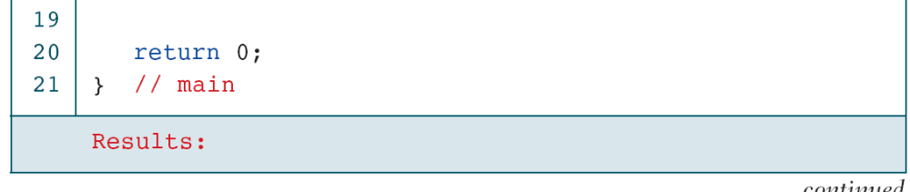
PROGRAM 3-10
Print Right Digit of Integer

Slide 59
PROGRAM 3-11
Calculate Average of Four Numbers

Slide 60
PROGRAM 3-11
Calculate Average of Four Numbers

Slide 61
PROGRAM 3-11
Calculate Average of Four Numbers

Slide 62
PROGRAM 3-11
Calculate Average of Four Numbers

Slide 63
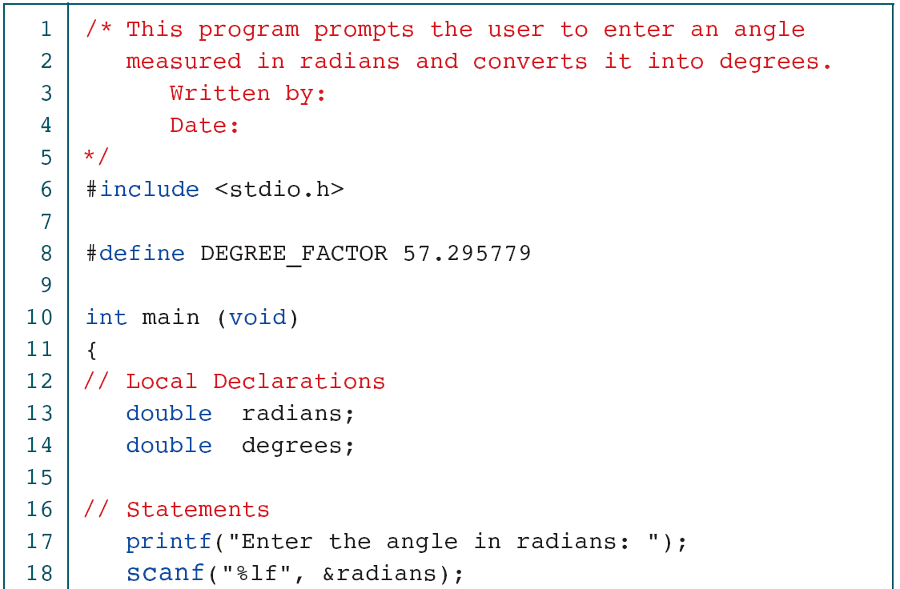
PROGRAM 3-12
Convert Radians to Degrees

Slide 64
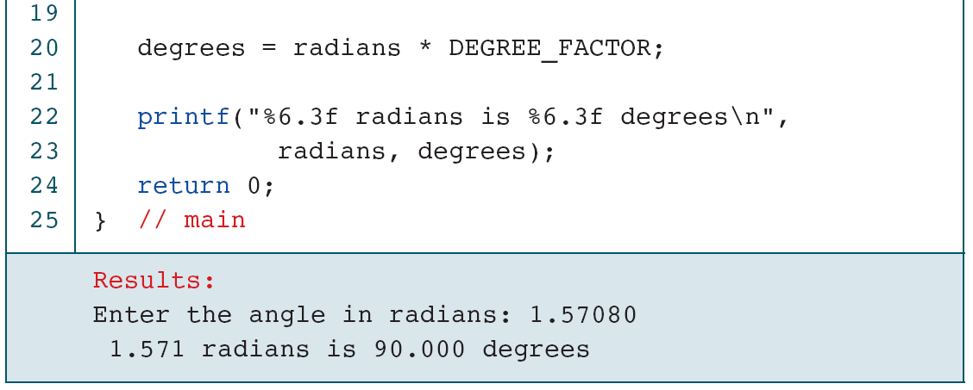
PROGRAM 3-12
Convert Radians to Degrees

Slide 65
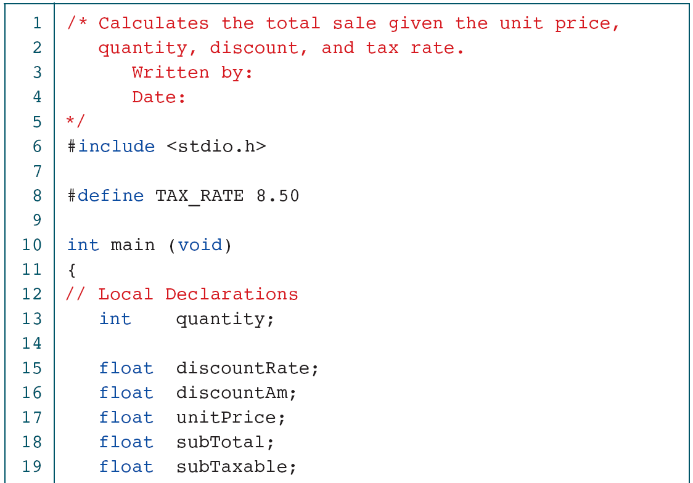
PROGRAM 3-13
Calculate Sales Total

Slide 66
PROGRAM 3-13
Calculate Sales Total

Slide 67
PROGRAM 3-13
Calculate Sales Total

Slide 68
PROGRAM 3-13
Calculate Sales Total

Slide 69
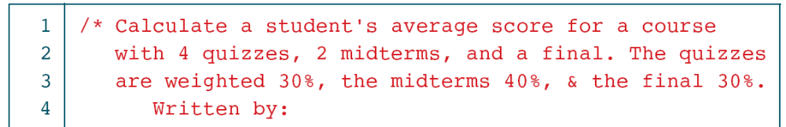
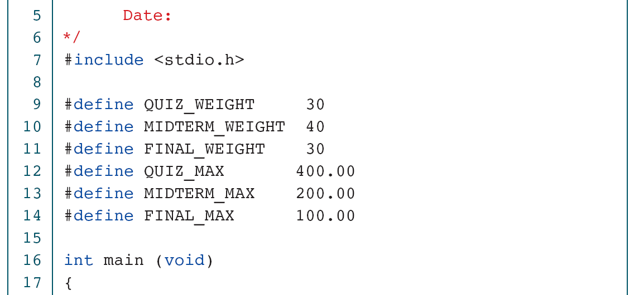
PROGRAM 3-14
Calculate Student Score

Slide 70
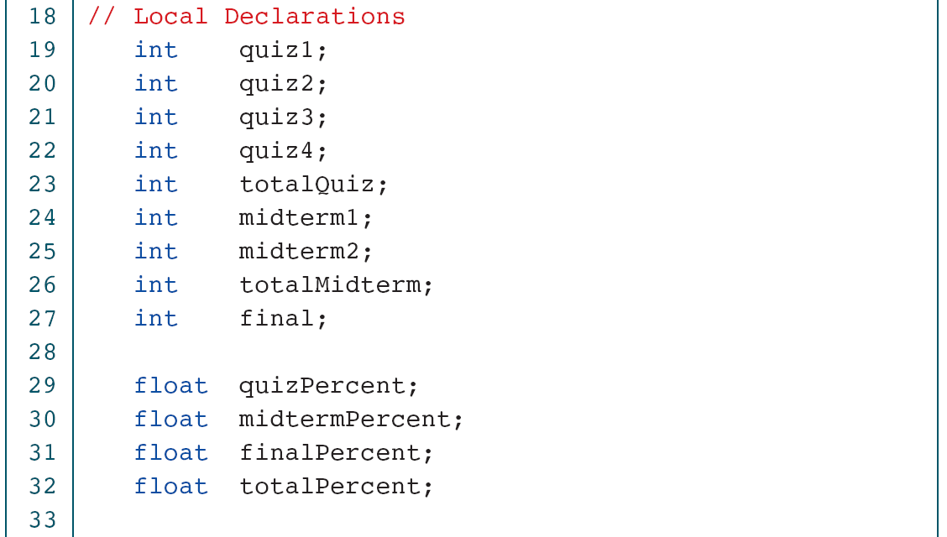
PROGRAM 3-14
Calculate Student Score

Slide 71
PROGRAM 3-14
Calculate Student Score

Slide 72
PROGRAM 3-14
Calculate Student Score

Slide 73
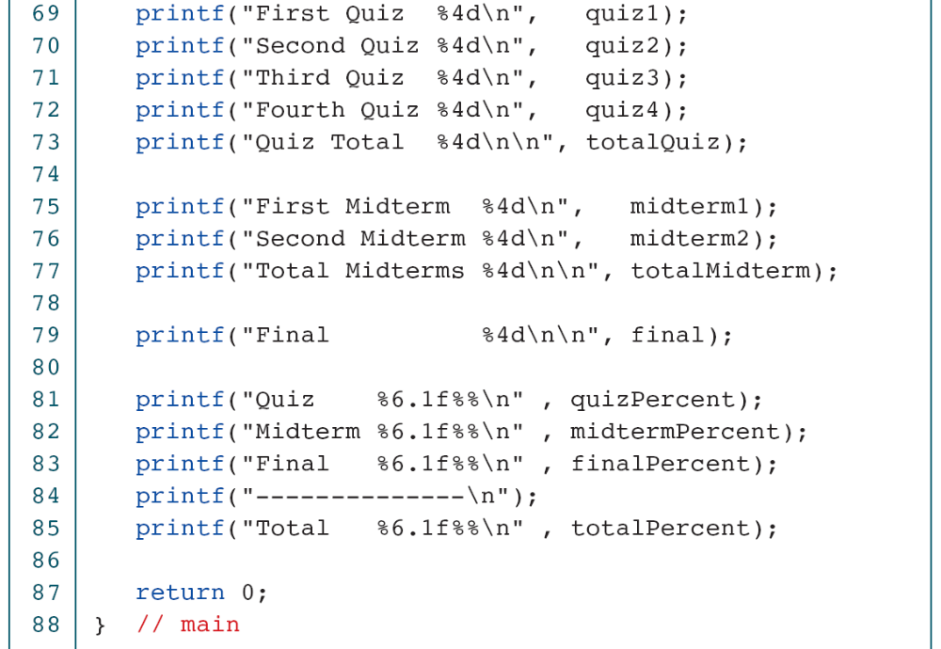
PROGRAM 3-14
Calculate Student Score

Slide 74
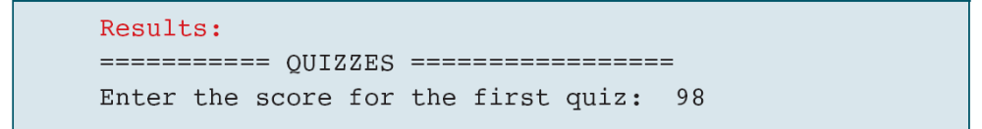
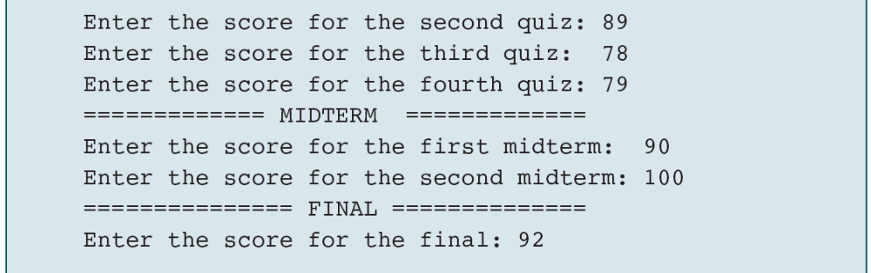
PROGRAM 3-14
Calculate Student Score

Slide 75
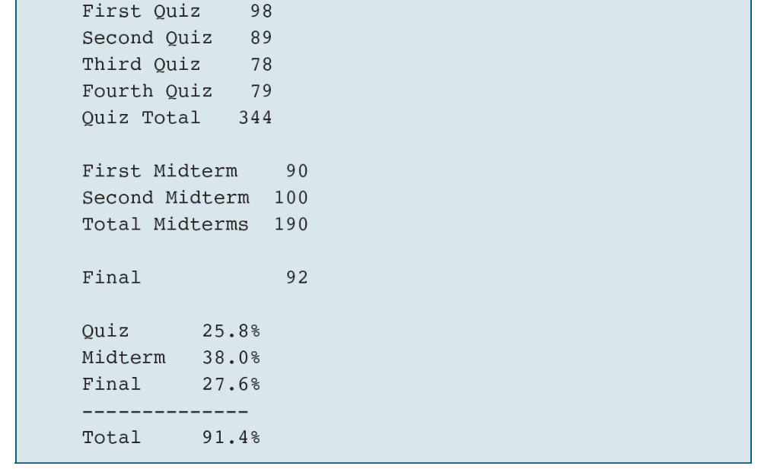
PROGRAM 3-14
Calculate Student Score

Slide 76
3-8 Software Engineering
In this section we discuss three concepts that, although technically not engineering principles, are important to writing clear and understandable programs.
Topics discussed in this section:
KISS
Parentheses
User Communication

Slide 77
Note
Blocks of code should be no longer than one screen.

Slide 78
Note
Computers do what you tell them to do,
not what you intended to tell them to do.
Make sure your code is as clear and simple as possible.

Slide 79
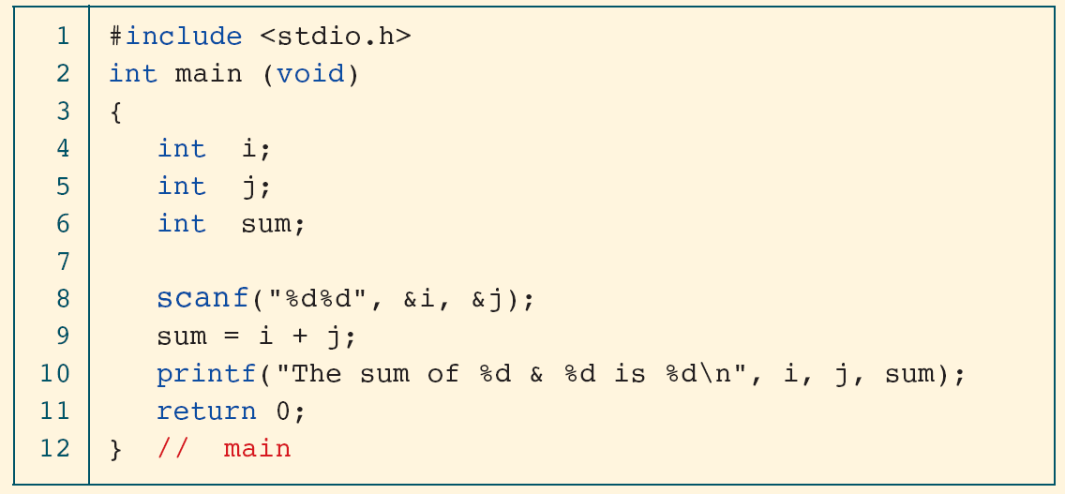
PROGRAM 3-15
Program That Will Confuse the User

